Slide 1
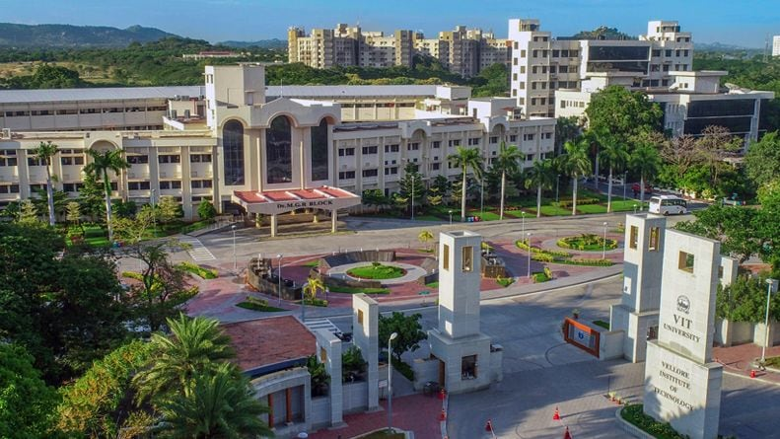

VITrip
A trip to – around – in VIT
Notes:
VITrip (a trip to around in VIT)

Slide 2
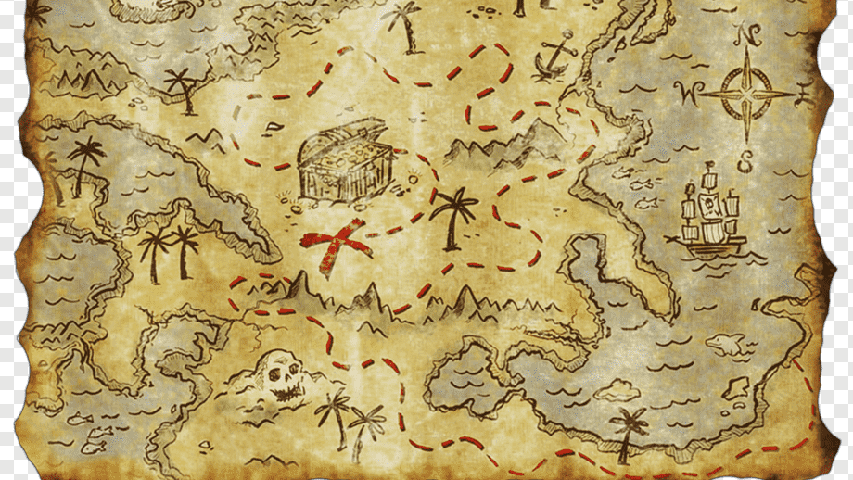
Team Members
Pallapothu Sri Akash (20BCB0027)
Mathew Alapat B (20BCB0106)
Guttikonda Jai Sai Naga Venkat (20BCE0734)
Mandar Rai A (20BCE2181)
Akshat Pattiwar (20BCI0258)

Slide 3
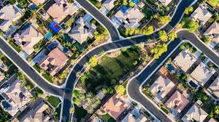
What’s included?
Review: 2
Title
Abstract
Problem statement
Process Flow Diagram
Modules
Prototype Design – One Page
Complete Front-end Design
Database Design and Details

Slide 4
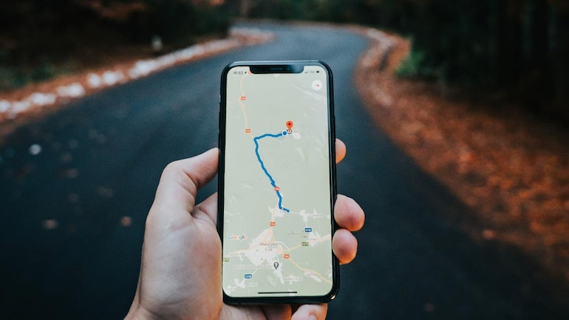
Title: VITrip (A trip to – around - in VIT)
Abstract:
In today’s world, web applications are very important. Most of the people use web applications to browse through any of their favourite topics or in any situation where they needs information about some topic. One of the applications related to this issue is our topic VITrip which is like a Travel Guide that helps you to plan your destinations, view any locations and help you with directions.
VITrip (A Trip to - around - in VIT) is a Travel Guide designed to show the maximum amount of information relevant to travellers in the most legible manner on the GPS. Buildings, gyms, pools, libraries, and many important landmarks are included, as are Medical Facilities with their individual icons. A pop up with detailed description will be displayed when their respective icon is clicked on.
Clients can post or check reviews, subscribe to the services and etc., there are many scopes of storing data by collecting through different means. Our team is trying to add as many features as possible to help the Navigation and make it easier and more accessible to use in any case.
Problem Statement:
We need to find a location in VIT? or when you want to reach a particular place? and get to know about it a little in advance? or find ways to reach here? Learn about different modes of transport? Find any pools, library, gyms etc.?

Slide 5
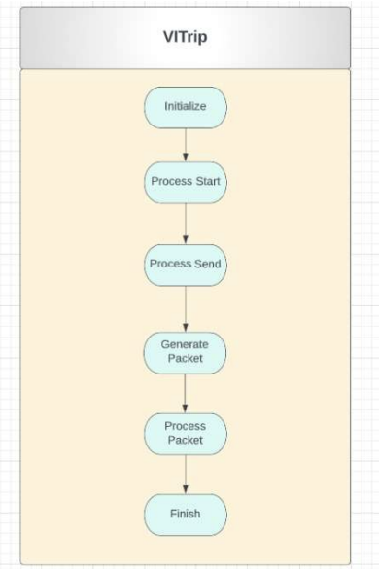
Process Flow Diagram

Slide 6
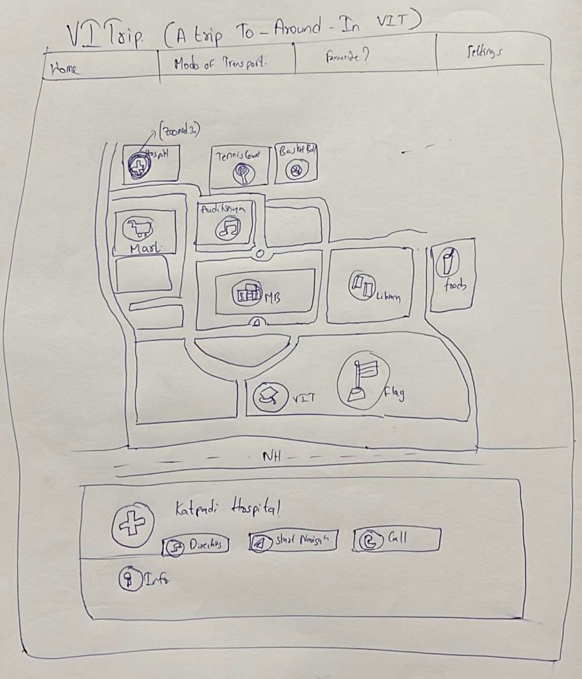
Prototype Design – One Page:
We made some changes to the prototype design and they can be seen in upcoming screenshots of our front end.
Modules: We mostly used these topics and some backend part is shown in review 3 later when discussed.
Web Designing
Client-Side Processing and Scripting
Server-side processing using Servlets
Server-side processing using Jsp
PHP and XML (directives and scripting, etc.)
Recent Trends in Internet or Survey process
Nodejs with npm and Reactjs

Slide 7

Complete Front-end Design
Github Repo Link:
https://github.com/JayakumarClassroom/FS22-23_IWP_B1-20BCI0258/tree/main/Project/Review%20-%202
We shown the frontend design of our project in the following sites,
As we run the codes we shown the output screenshots in next page of various html pages.
However its not a single page but multiple pages connected so we shown some screenshots in the next and so the next slides will show the screenshots of our fontend

Slide 8
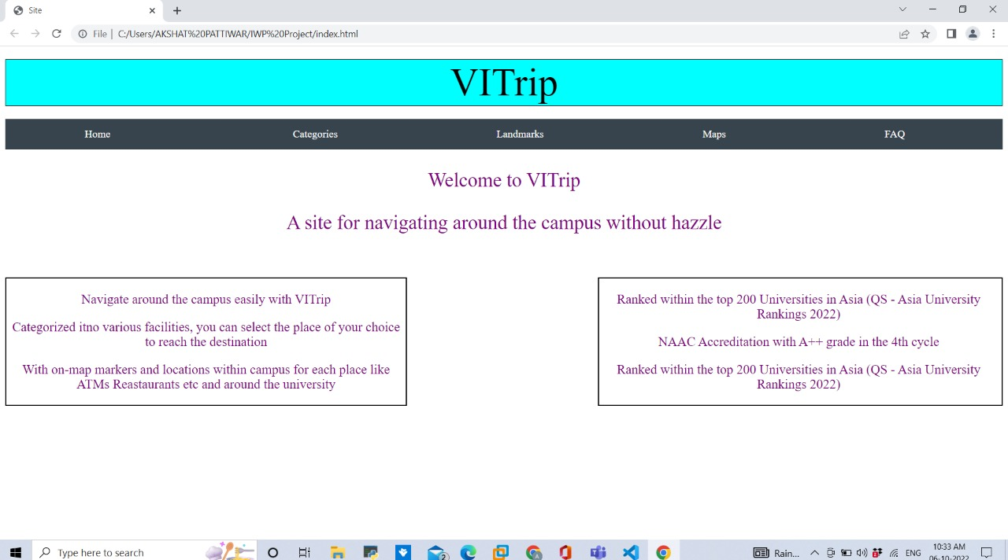
VITrip index.html

Slide 9
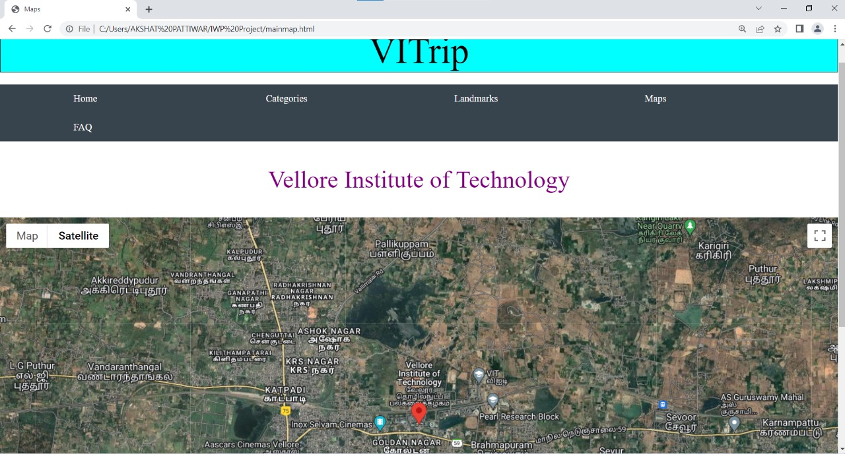
VITrip mainmap.html

Slide 10
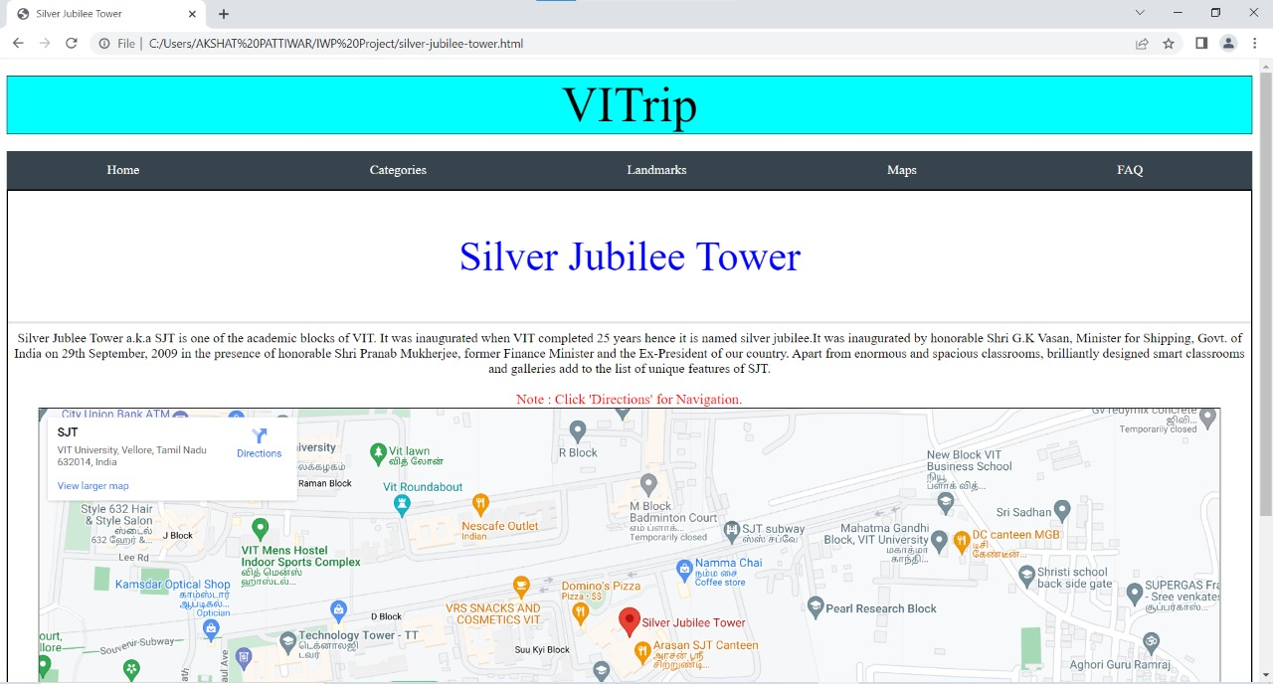
VITrip silver-jubilee-tower.html

Slide 11
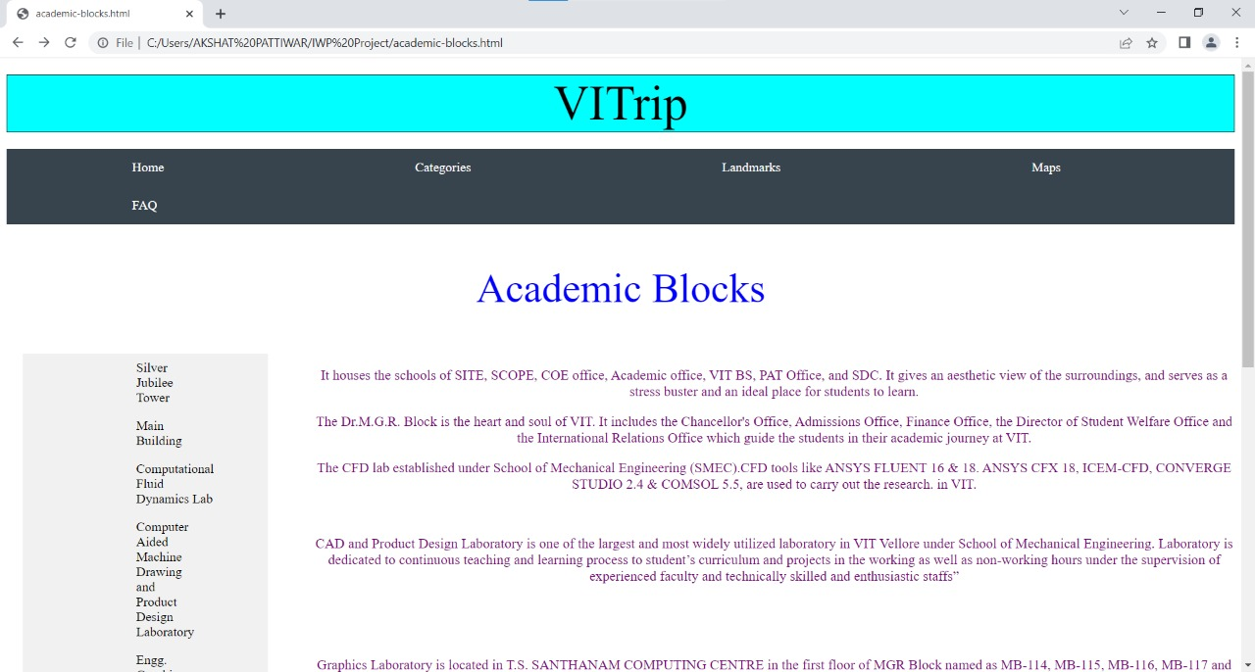
VITrip academic-blocks.html

Slide 12
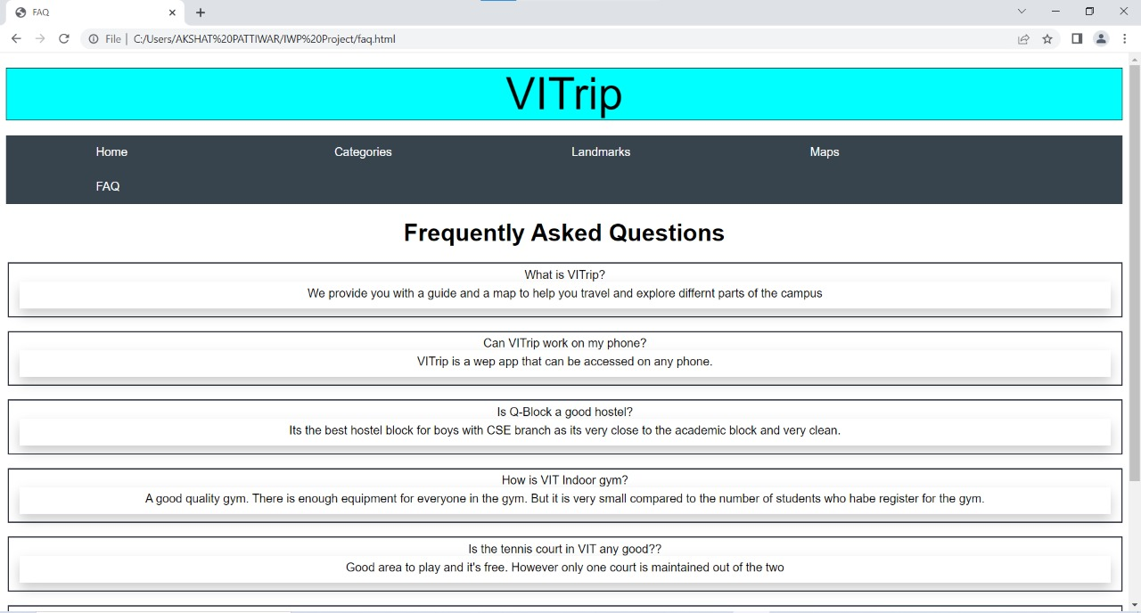
VITrip faq.html

Slide 13
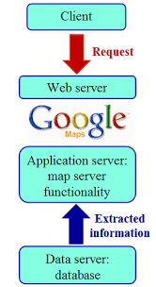
Database Design and Details
We used google maps api in our connection to the maps and in the back end we will add the database and the design will be shown in next review.

Slide 14


